Slide 1
2020
The integration power
Manuel Sánchez
Technical Manager at everis | Microsoft MVP Azure
@Manuss20
Global Integration
Bootcamp

Slide 2
Sponsors

Slide 3


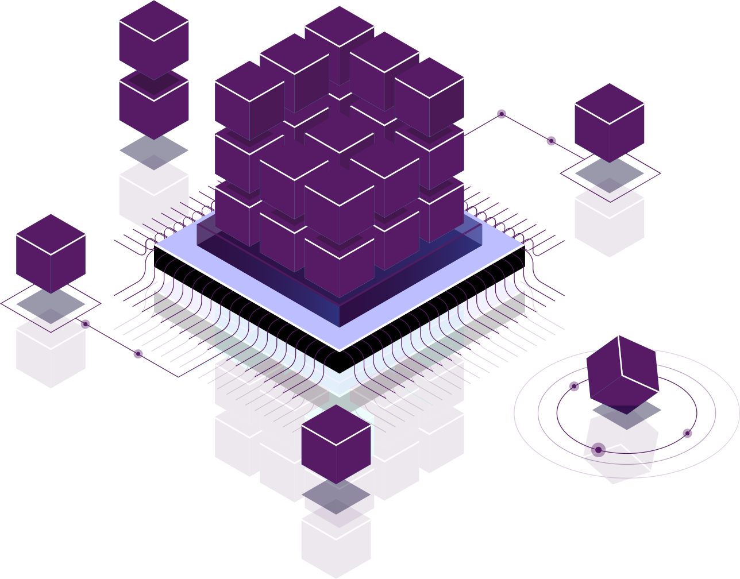
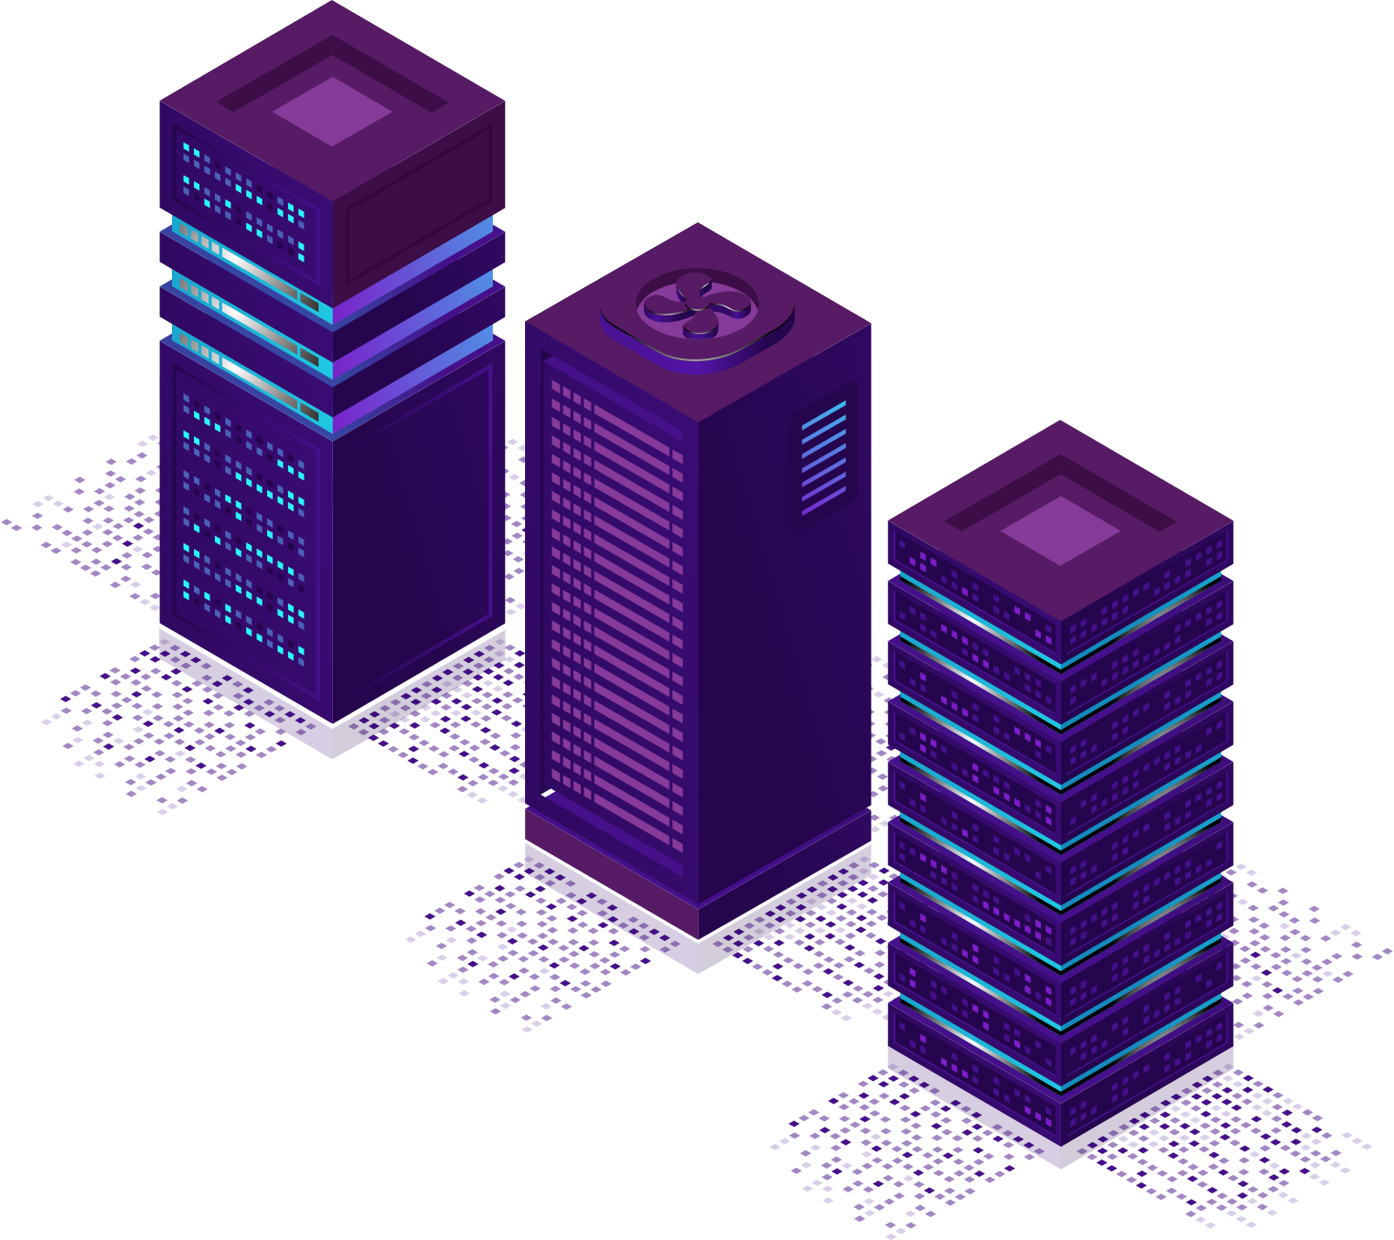
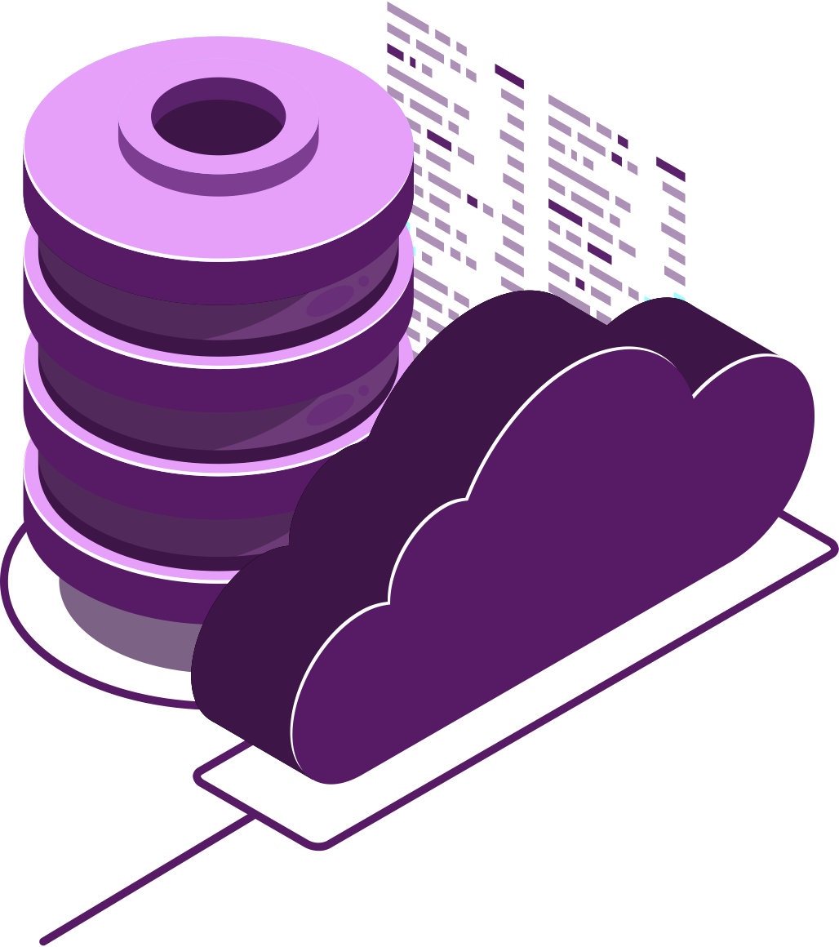
Manuel Sánchez Rodríguez
Technical Manager at everis | Microsoft MVP Azure
@Manuss20
Passionate about new technologies, highlighting Netcore , Microsoft Azure, Xamarin, IA, Bots and ASP.NET. Passionate about team management. I contribute to the developers community writing articles in my personal blog and giving speeches in numerous events. I am also one of the Netcoreconf leads.

Slide 4
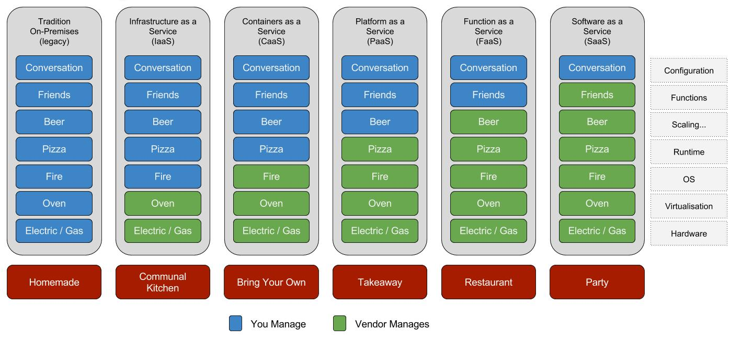
Pizza as a Service

Slide 5
New Logic Apps for easy automation
No code designer for rapid creation
Dozens of pre-built templates to get started
Out of box support for popular SaaS and on-premises apps
Use with custom API apps of your own
BizTalk APIs for expert integration scenarios
LOGIC Apps
Automate business process across SaaS and on-premises
Notes:
Azure Logic Apps es un servicio en la nube que le ayuda a automatizar y organizar tareas, procesos empresariales y flujos de trabajocuando tiene que integrar aplicaciones, datos, sistemas y servicios en empresas u organizaciones. Logic Apps simplifica el diseño y la compilación de soluciones escalables de integración de aplicaciones, integración de datos, integración de sistemas, Enterprise Application Integration (EAI) y comunicación de negocio a negocio (B2B), ya sea en la nube, localmente o en ambos entornos.
Por ejemplo:
- Procesamiento y redirección de pedidos de sistemas locales y servicios en la nube.
- Envío de notificaciones por correo electrónico con Office 365 cuando se producen eventos en varios sistemas, aplicaciones y servicios.
- Traslado de archivos cargados de un servidor SFTP o FTP a Azure Storage.
- Supervisión de tweets sobre un asunto específico, análisis de opiniones y creación de alertas o tareas para los elementos que deben revisarse.

Slide 6
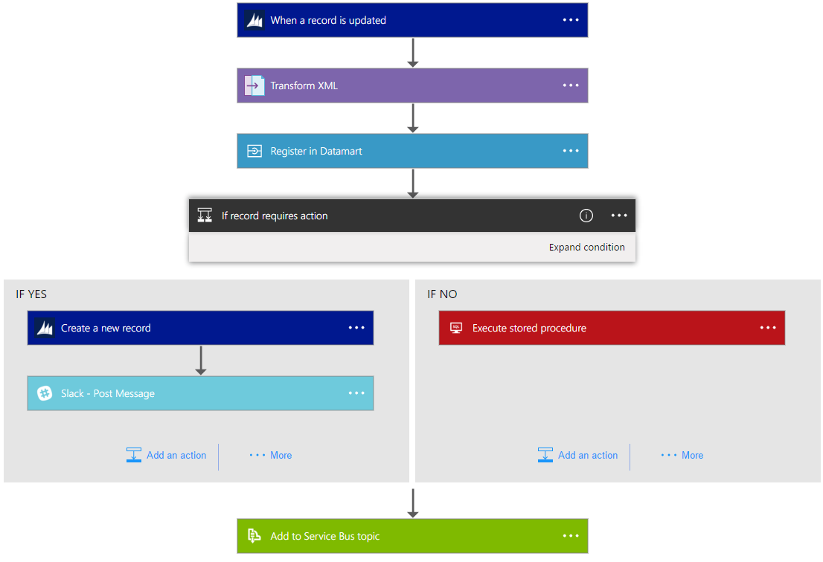
Introducing Azure Logic Apps
Powerful Integration. Hyperscale Workflow Engine, born in Azure
Faster integration using innovative Visual Designer
Easy workflow creation with triggers and actions
Mashup applications, data and services
Built for mission critical Enterprise Integration
Create, deploy, manage and monitor

Slide 7
Logic Apps is Event Driven
Triggers
Recurrence & Adv. Scheduling
Polling
Webhook
Request

Slide 8
Logic Apps is Workflow
Actions
Invoke APIs & Services
Behaviors
Flow Control
Message Handling
Expressions & Operators
Variables
Notes:
Invokes Services
Managed connectors
App Service APIs
API Management
Azure Functions
Workflow
HTTP + Swagger
HTTP
Behaviors
Retry policy
Run after
Limit
Operation Options
Response
Webhook
Delay
Terminate
Message Handling
Compose
Query
Table
Request schema
Parse JSON
Xpath & XSLT
XML Validation
Flow Control
Scope
Foreach
DoUntil
Switch
Condition
Expressions & Operators

Slide 9
Logic Apps is B2B Enterprise Messaging
Integration Account
EDI
XML handling
Business tracking
Trading Partners
Flat File handling
Notes:
Invokes Services
Managed connectors
App Service APIs
API Management
Azure Functions
Workflow
HTTP + Swagger
HTTP
Behaviors
Retry policy
Run after
Limit
Operation Options
Response
Webhook
Delay
Terminate
Message Handling
Compose
Query
Table
Request schema
Parse JSON
Xpath & XSLT
XML Validation
Flow Control
Scope
Foreach
DoUntil
Switch
Condition
Expressions & Operators

Slide 10
Logic Apps is Secure
Access Configuration
RBAC
Static IPs
IP constraints
Regenerate access keys
Auditing

Slide 11
Logic Apps is Manageable
DevOps
Trigger & run history
Monitoring view
Version history & Rollback
Diagnostics & Alerts
Operations Management Suite
Visual Studio tooling

Slide 12
Logic Apps is Certified
Certifications
Drummond AS2
ISO 27001
SOC (I, II, II)
HIPAA
PCI DSS
Notes:
HIPAA - Health Insurance Portability & Accountability Act with Business Associate Agreements (BAAs).
PCI DSS - Payment Card Industry Data Security Standards Level 1 version 3.1.
SOC - Service Organization Controls standards for operational security

Slide 13
Logic Apps is Connected
Cloud APIs and platform functionality
Over 150 built-in connectors
Hosted and managed within the platform
Scales to meet your needs
First class designer experience
Rapid development
API connections
Authenticate once and reuse
Differentiate connection configuration
Simple to deploy
Portal experience for managing API Connections
Notes:
Call out that we now support stored procs on-prem

Slide 14
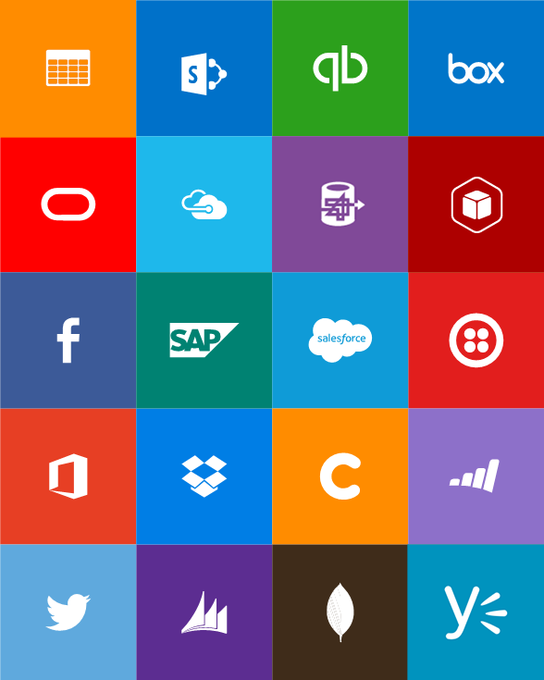

Built-in API Connectors
SaaS
Hybrid
Box
Chatter
Dropbox
Azure HD Insight
Slack
Azure Media Services
OneDrive
SharePoint
SQL Azure
Office 365
QuickBooks
SalesForce
Sugar CRM
Dynamics CRM
Azure Service Bus
Azure Storage
Timer / Recurrence
Twilio
Twitter
Azure Web Jobs
Yammer
IBM DB2
Informix
Websphere MQ
SQL Server
SharePoint Server
Oracle
SAP
Hybrid Connectivity
BizTalk Messaging & B2B
Protocols
Batching / Debatching
Validate
Extract (XPath)
Transform (+Mapper)
Convert (XML-JSON)
Convert (XML-FF)
X12
EDIFACT
AS2
TPM
Rules Engine
Flat file
HTTP, HTTPS
FTP, SFTP
POP3/IMAP
SMTP
File
Delay

Slide 15

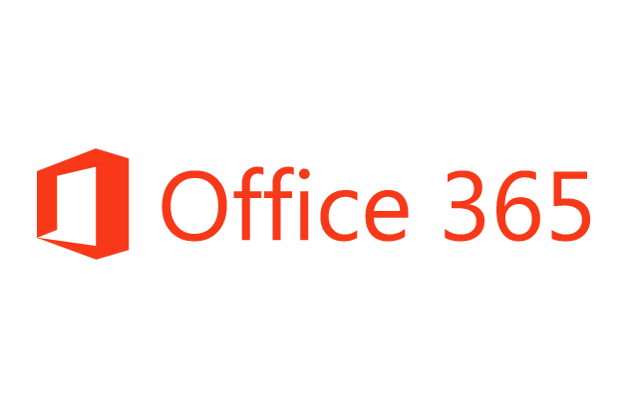










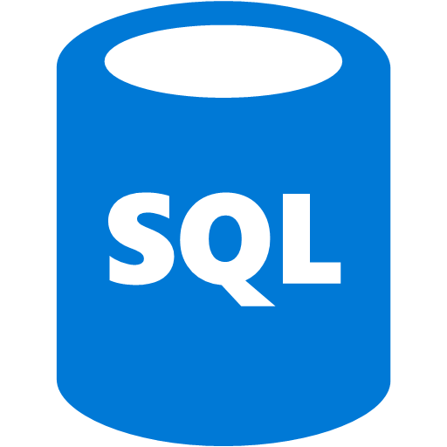


Logic Apps connects everything
Hybrid
Secure Gateway
As easy as connecting to cloud services
Better Together
Rich Azure Services
API Management
Azure Functions
Complete
PaaS Support
B2B Capabilities
SaaS Connectors
Machine Learning
B2B & EDI
Service Bus
Logic Apps
Cognitive Services
API Management
On-premises data gateway
BizTalk Server
Notes:
Logic Apps can integrate with “anything” (APIs) and solve small or complex problems. Automation in a secure and reliable environment fast and easy.
Connect Anything:
On-premises, hybrid and cloud
Mission critical, complex integration scenarios
Business productivity
Agile Business:
Quickly create workflows
Position to the future API centric
Transform Business:
Extract value from both (on-premises and cloud apps)
Build Holistic integration solutions.

Slide 16
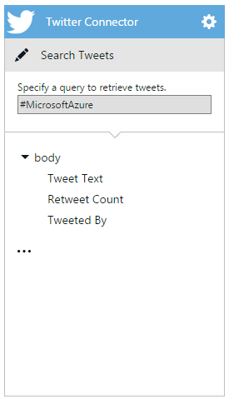
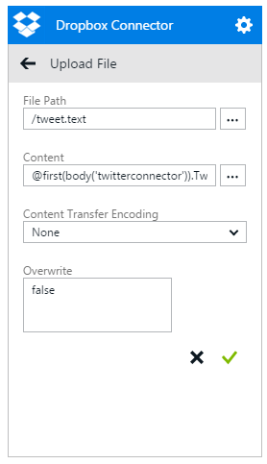
Logic apps for orchestration across API apps
Implicitly – whenever you reference the output of an action you’ll depend on that action executing first
Explicit “dependsOn” condition – you can mark certain actions to run only after previous ones have completed
Explicit “expression” condition – a complex function that evaluates properties of other actions

Slide 17
Control flow
Response
For Each
Split On
Do Until
Conditions

Slide 18
Repeating
Loop a single action over a list of items
Runs the action N times
You can get at all of the statuses for each action
Tip: when you have multiple collections use:
"repeat" : "@range(0,length(body('connector1')))"
…
"inputs" : "@concat(body('connector1')[repeatItem()], body('connector2')[repeatItem()])"

Slide 19
Conditionals
Logic on a trigger or action
For triggers conditionals are post-conditions
For actions conditionals are pre-conditions
You can do conditionals inside of repeats to perform as a filter

Slide 20
Demo

Slide 21
Q&A

Slide 22
Agradecimientos

Slide 23
Thanks

